Slide 1
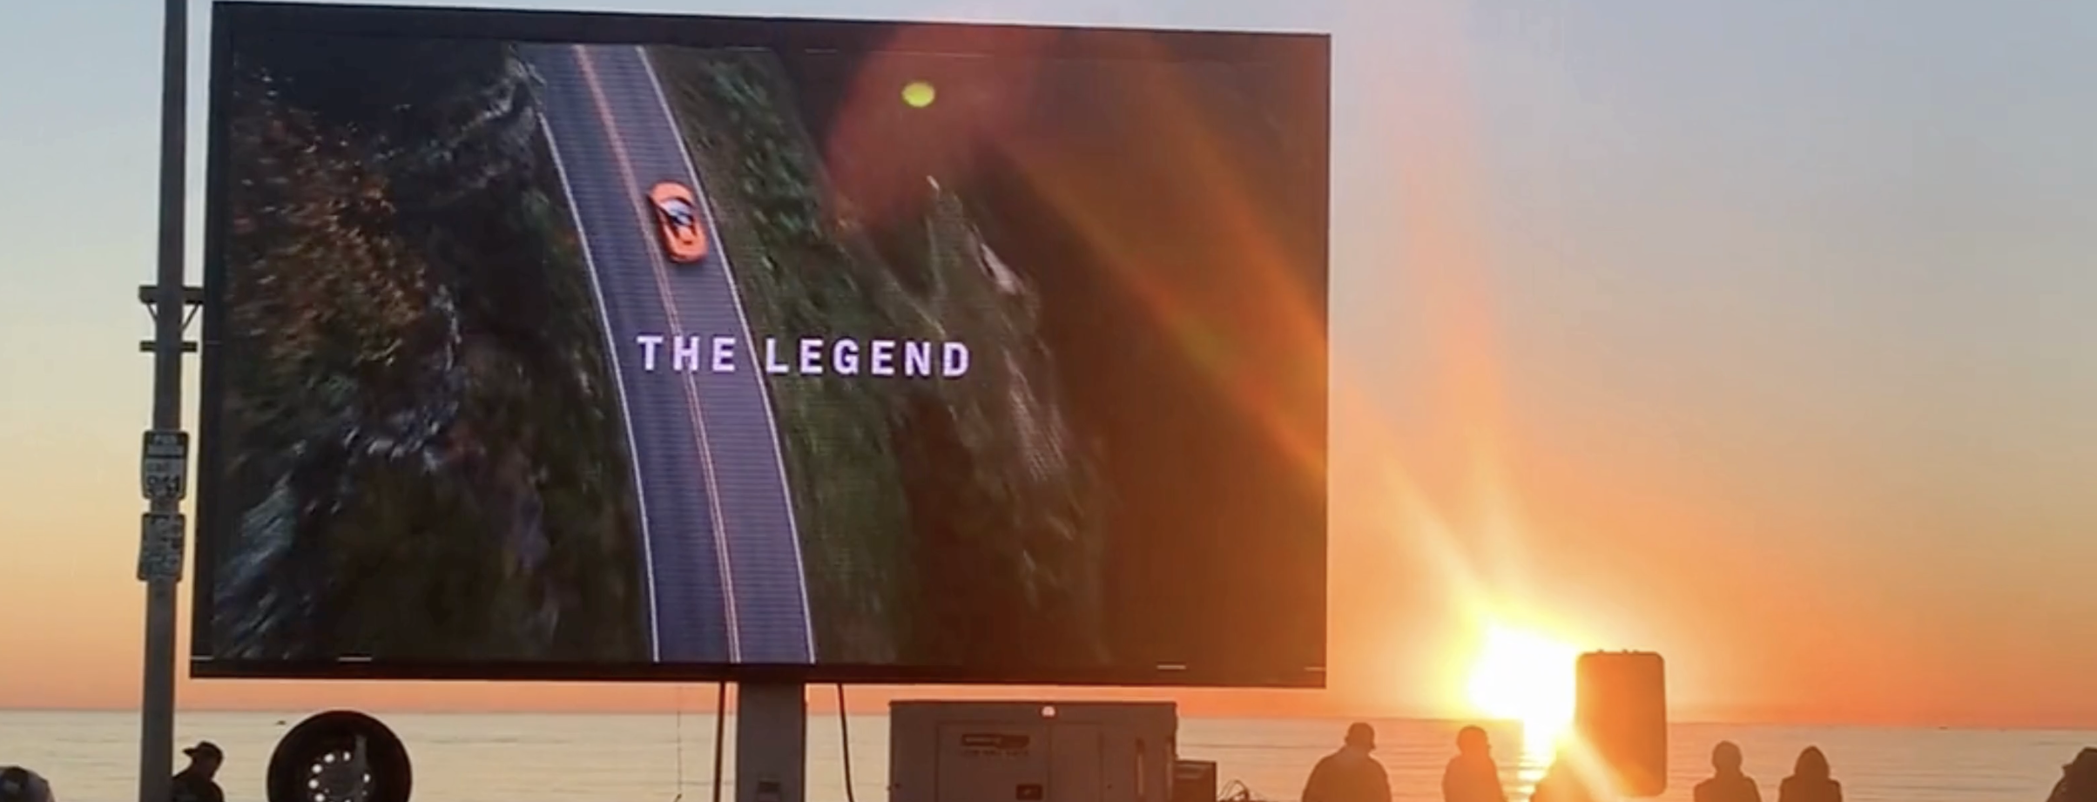

Community-Supported Seaside Theater
Community Partnership Proposal
A Community Partnership Opportunity with Southern California Edison

Slide 2
Overview
This proposal presents a community-focused cultural support initiative in partnership with Southern California Edison (SCE), centered on free outdoor film screenings at one of Los Angeles’ most iconic local beaches, Venice Beach.
The project supports the Seaside Theater, an oceanfront movie experience originally initiated by the owner of Hinano Cafe as a way to give back to local residents and families.
With SCE’s support, this initiative can grow into a meaningful and ongoing form of community and cultural contribution.

Slide 3
Why Seaside Theater
Venice Beach is one of Los Angeles’ most recognizable beaches, yet it remains deeply rooted in local community life.
Unlike more tourist-oriented coastal areas, Venice is home to families, long-term residents, artists, and small local businesses who use the beach as part of their daily lives.
When comparing Venice Beach with Santa Monica, city tourism data and local business district reports consistently show a clear difference in annual visitor composition:
Santa Monica receives a significantly higher volume of out-of-town and international tourists year-round, driven by large hotels, shopping districts, and tour-based visitation.

Slide 4
Why Seaside Theater
Venice Beach, by contrast, has a higher proportion of local and repeat visitors, including neighborhood residents, families, and creatives who return weekly or monthly throughout the year.
In other words, while Santa Monica functions primarily as a tourism destination, Venice Beach functions as a living community space—a place where local residents gather, relax, and connect.
Supporting a free cultural experience in this setting allows Southern California Edison to align naturally with:
Community engagement
Accessibility and inclusion
Family-friendly public programming
Long-term neighborhood support
This is a community-first initiative, not a commercial activation.

Slide 5
Why Japanese Animation
Japanese animation has become a globally shared cultural language and is especially beloved across generations in the United States.
Well-known titles such as:
Dragon Ball
Sailor Moon
Pikachu
One Piece
Demon Slayer: Kimetsu no Yaiba
are enjoyed by children, parents, and adults alike.
Beyond these examples, countless other Japanese animated works have become part of everyday American culture, spanning family entertainment, storytelling, and artistic expression.
These works create connection, nostalgia, and inspiration across age groups, making Japanese animation uniquely suited for a public, family-oriented community event.
Offering these films free of charge and open to all transforms entertainment into a shared cultural experience—one that encourages inclusion, cross-generational connection, and stronger community bonds.

Slide 6
Cultural Access, Business Intent, and Role Clarity
This project is made possible through a direct cultural and linguistic bridge between Japan and the United States.
The project proposer, Miho Nobusawa, has close family ties to senior leadership at Toei Animation, one of Japan’s most respected animation studios responsible for many internationally beloved works.
While Miho Nobusawa is not engaged in the animation production or distribution business, this initiative represents her new business venture, focused on community-centered cultural partnerships and future-oriented brand support.
The purpose of this business is not to commercialize content, but to:
Support the happiness and well-being of local residents
Create meaningful cultural experiences that are open, inclusive, and free to the public
Help organizations such as Southern California Edison participate in projects that are genuinely valued by the community
Miho’s role within this business is to:
Facilitate cultural and language alignment between Japan and the United States
Support communication with Japanese content stakeholders where appropriate
Design collaborations that are handled respectfully, smoothly, and with cultural sensitivity
This initiative is founded on the belief that the future of advertising and sponsorship lies in contribution, not promotion.
By supporting community-driven cultural experiences, brands become part of a shared positive memory—functioning as a form of modern volunteerism, social goodwill, and long-term trust-building, rather than traditional advertising.
This combination of trusted cultural access and a clearly defined, community-focused business model is rare and significantly lowers the barriers that often exist in cross-border cultural projects.

Slide 7
Why This Matters to Southern California Edison
This partnership is not about promotion—it is about presence and participation.
Through support of the Seaside Theater, Southern California Edison demonstrates:
Genuine care for local families and residents
Commitment to inclusive, non-commercial community experiences
Support for arts, culture, and youth engagement
A forward-looking vision of corporate social responsibility
In addition, this initiative creates a clear pathway for future cultural collaborations.
For example, large-scale anime-related events have already demonstrated strong community engagement and fan enthusiasm in Los Angeles.
The One Piece Night 2025 at Dodger Stadium serves as a strong reference point—showing how Japanese animation can successfully connect sports, families, and diverse audiences in a public, celebratory setting.
By building on this momentum, Southern California Edison has the opportunity to explore future collaborations between Japanese animation companies and local sports or entertainment venues, including stadium-based cultural events that bring communities together beyond traditional sponsorship models.
Through her new business focused on community-centered cultural partnerships, Miho Nobusawa is able to support future outreach and relationship-building with Japanese animation stakeholders for stadium and regional events, should Edison wish to pursue such initiatives.
These experiences help create positive emotional associations with the Edison name—turning cultural support into lasting goodwill.
SCE’s involvement becomes part of a positive, shared memory for the community—something that cannot be achieved through traditional advertising alone.

Slide 8
Conclusion
The Seaside Theater project offers Southern California Edison an opportunity to:
Support local communities in a meaningful and visible way
Celebrate cultural diversity through universally loved storytelling
Create joyful, inclusive experiences for children and adults alike
Strengthen trust and connection within a vital Los Angeles neighborhood
This initiative reflects a future-oriented approach to community engagement—open, thoughtful, and human-centered.

